Slide 1
Buckling of Soft Cylinders
ES 242R Final Project
Helen Read

Slide 2
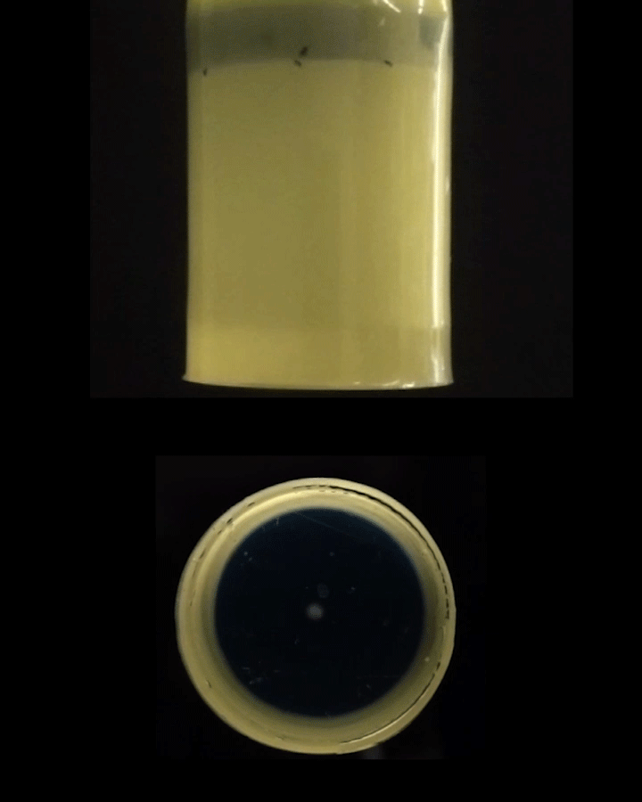
Background
This is an ongoing project of my labmate, Yi Yang
FEM work was previously done by David Melancon
We suction air out of thin-walled soft cylinders
Two regimes of behavior:
(1) initial buckling event that creates folds and
(2) twisting of cylinder (for # folds > 2)

Slide 3
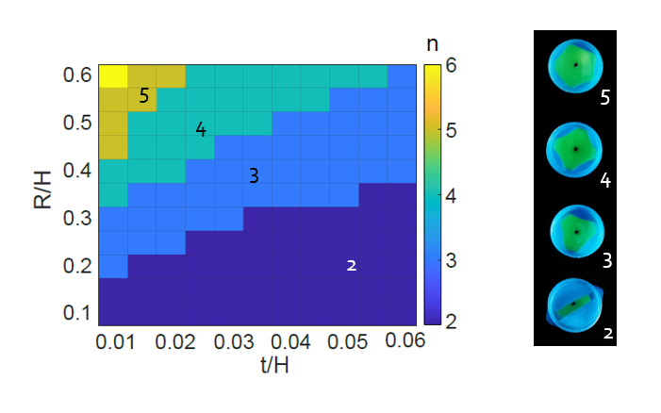
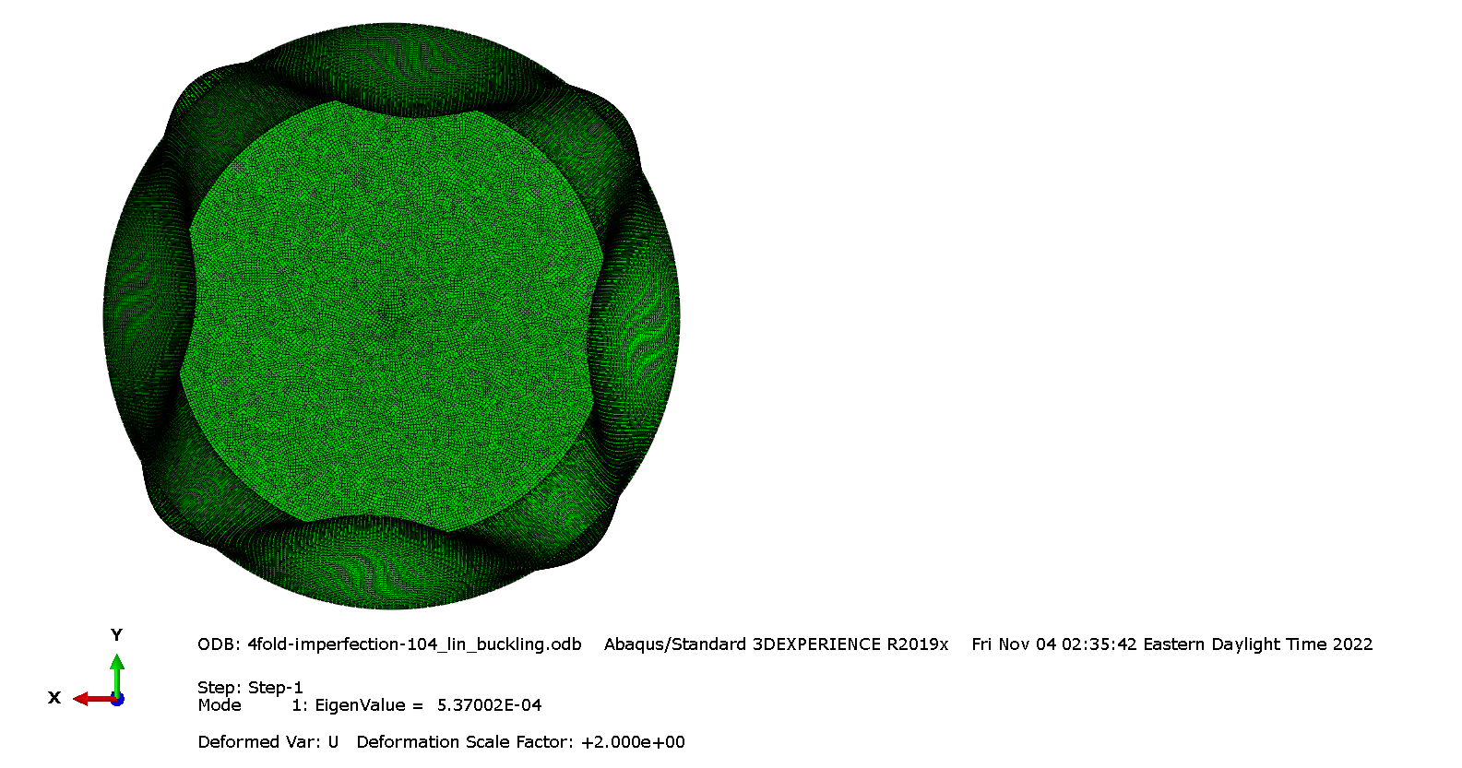
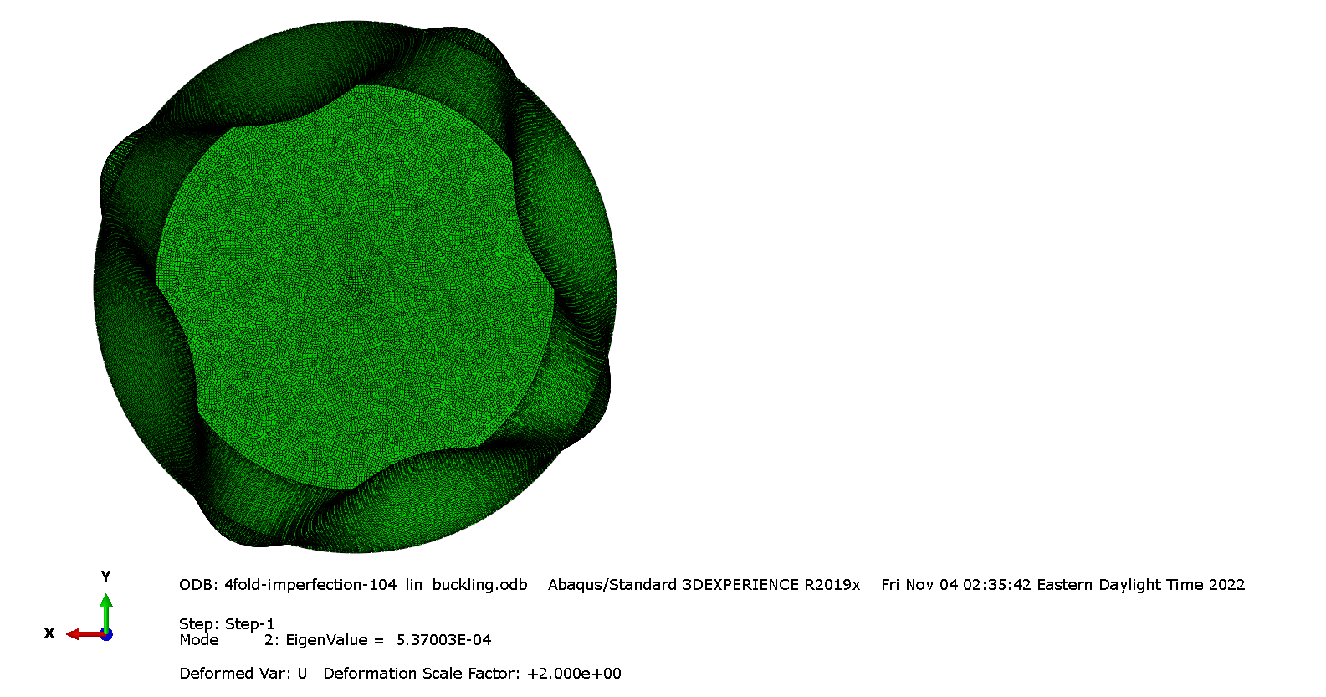
Background
The initial regime of buckling is well understood
Can be captured by a buckling step in abaqus
An analytical model exists too!
The post-buckling twisting behavior is less well understood

Slide 4
Can we understand post-buckling behavior of soft cylinders?

Slide 5
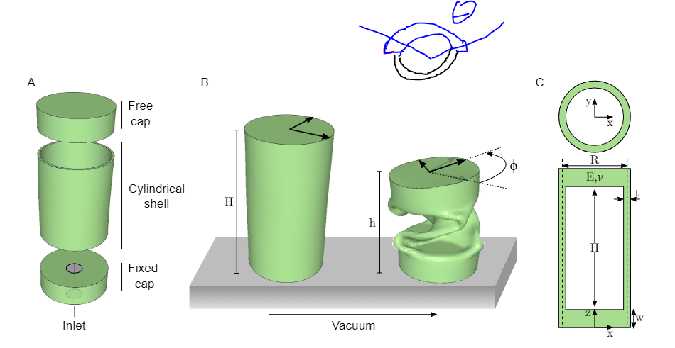
Simulation Setup
We have 3 parts
2 caps (free and fixed)
1 shell
For simplicity, we fix the edge of the cylindrical shell instead of modeling the fixed cap
All elements used are shells, currently S4R

Slide 6
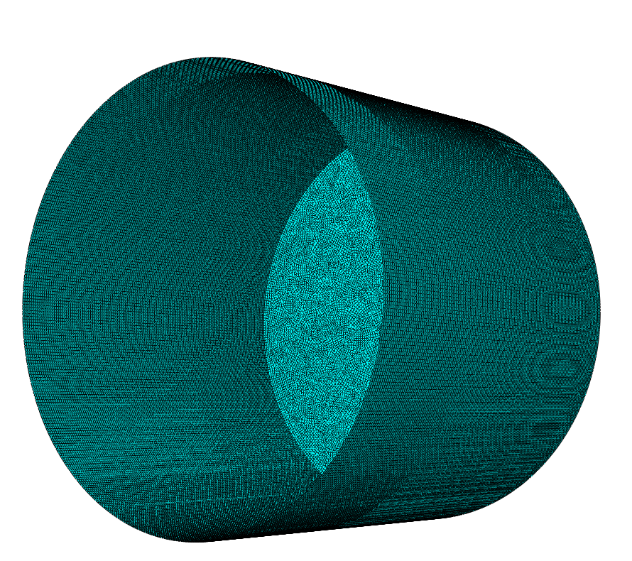
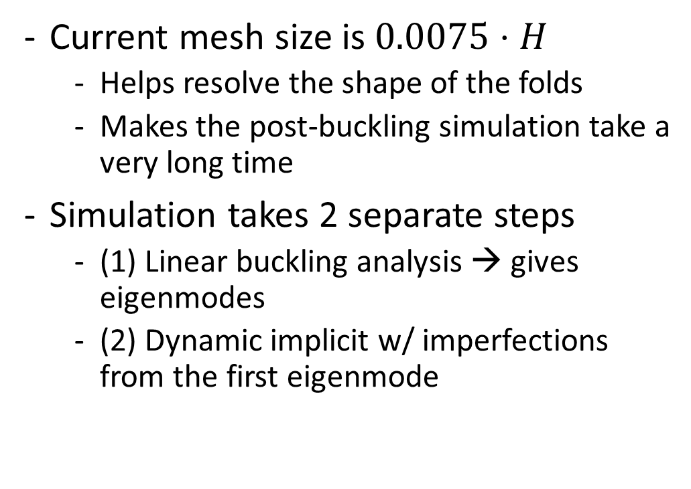
Simulation Setup
Current mesh size is $0.0075⋅H$
Helps resolve the shape of the folds
Makes the post-buckling simulation take a very long time
Simulation takes 2 separate steps
(1) Linear buckling analysis → gives eigenmodes
(2) Dynamic implicit w/ imperfections from the first eigenmode

Slide 7
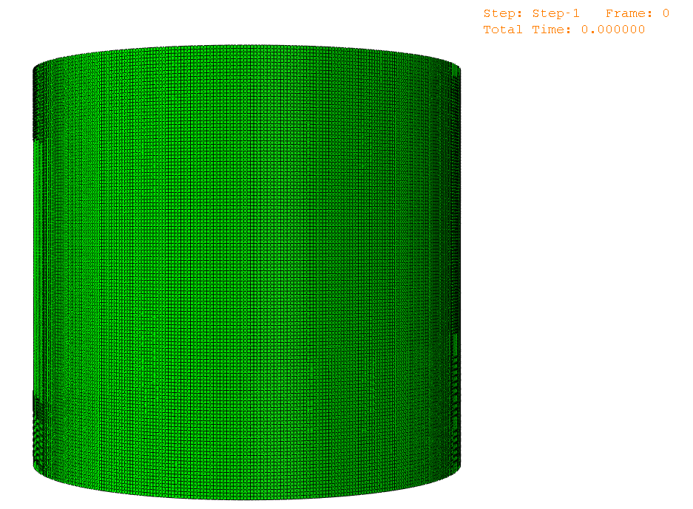
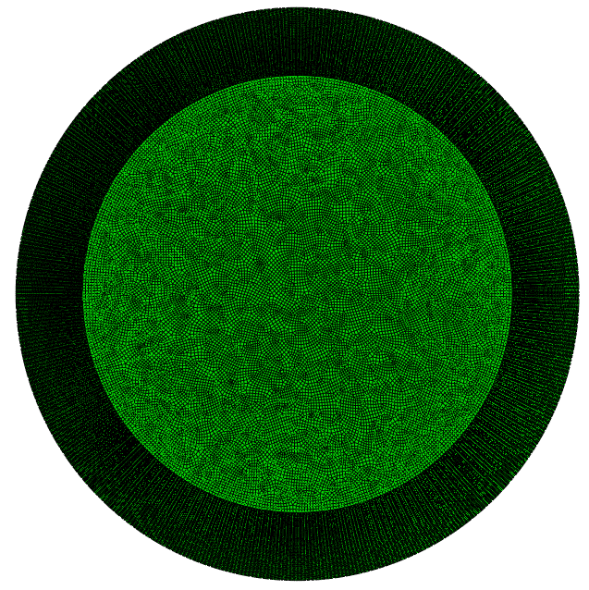
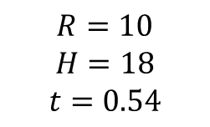
Current State
$$R=10$$
$$H=18$$
$$t=0.54$$

Slide 8
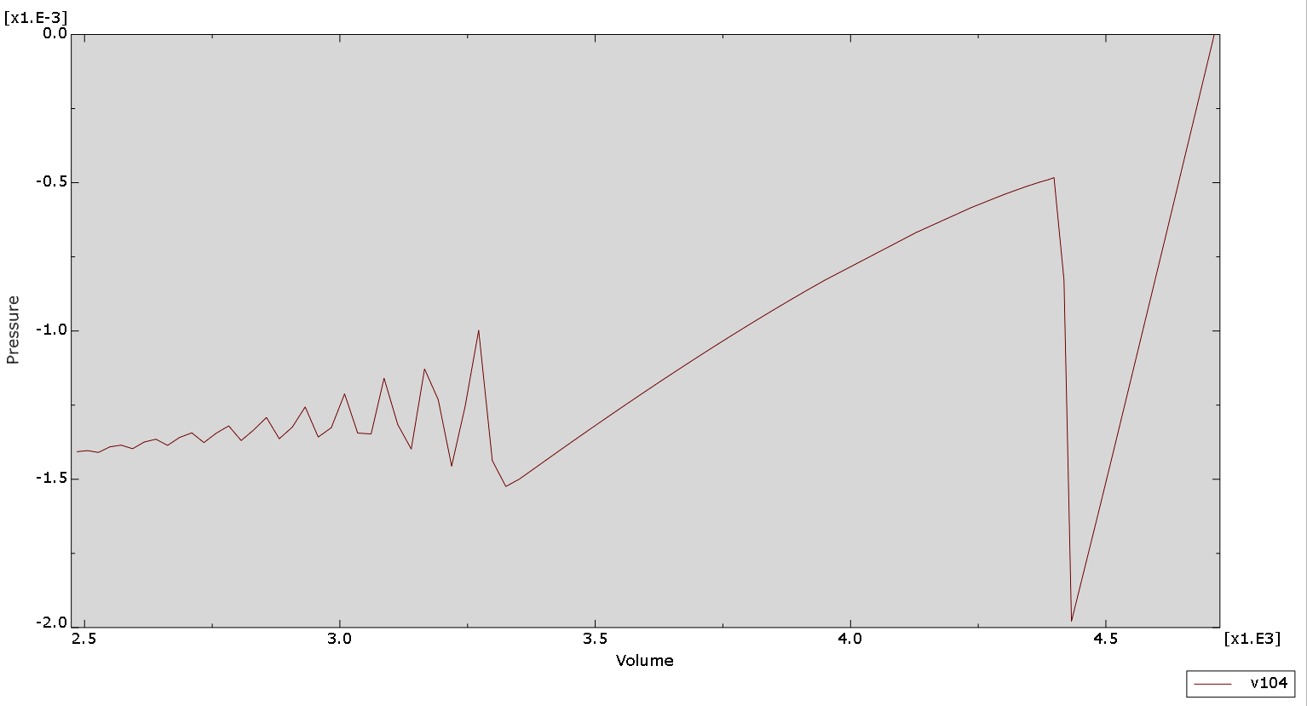
Current State
1st buckling event
time
2nd buckling event?

Slide 9
Overall plan
Investigate if the twist is a buckling event
Run dynamic implicit up to “near” the initial twisting
Run buckling analysis as a second step
Do the two buckling modes Abaqus finds twist the same way?
In real life, where does this instability come from?
Can we create a simpler model for this system?
Beam model using the # of beams to match # folds
p

Slide 10
Questions/Comments/Suggestions?

